Slide 1
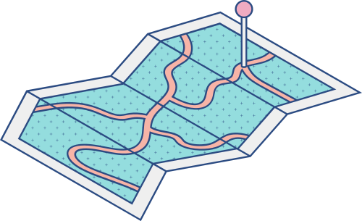

PROPERTY LISTINGS FROM LAMUDI.COM IN METRO MANILA
GROUP 1:
MARINO, DAFNY
PACANOR, EDMALYN

Slide 2
BUSINESS PROBLEM
PROVIDE RENTERS KNOWLEDGE ON THE PROPERTY PRICES BASED ON THEIR CHOSEN LOCATION, PROPERTY TYPE, AND PRICE.

Slide 3
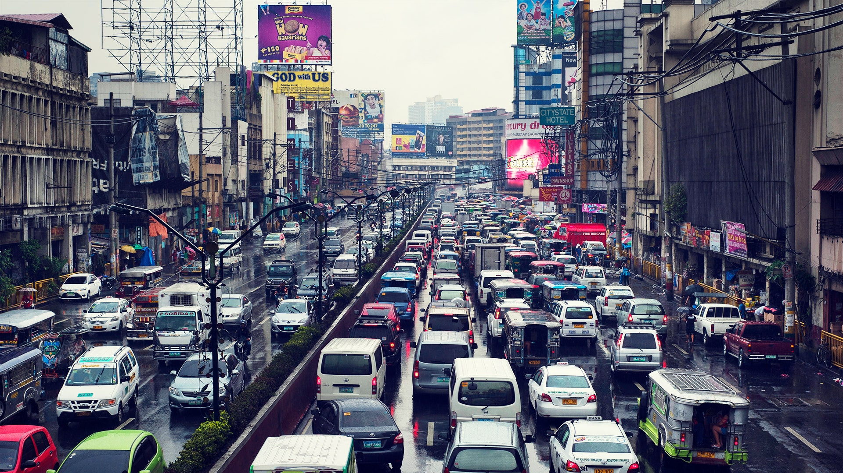
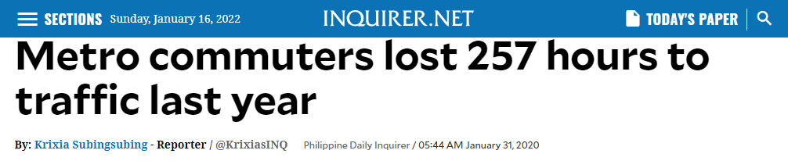
32 WORKING DAYS LOST

Slide 4






commuting
renting
vs
32 WORKING DAYS LOST TO TRAFFIC
THE NEED TO WAKE UP EARLY RESULTING TO DROWSINESS AT WORK
STRESSFUL OVERALL
HAVE TO PAY MONTHLY RENT

Slide 5
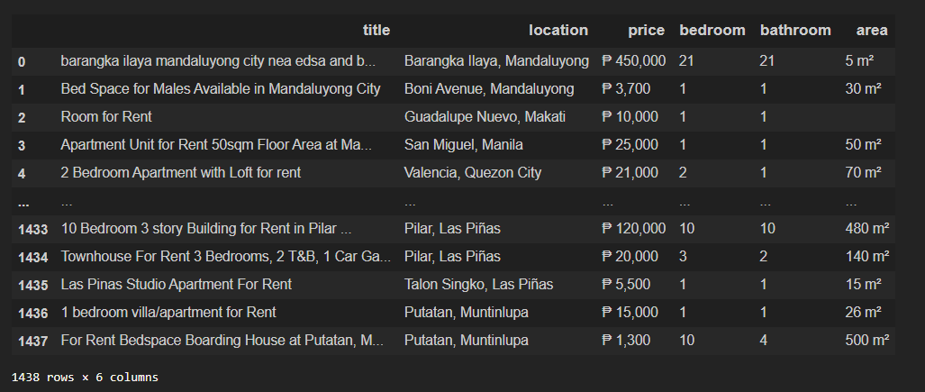
DATASET
WEBSCRAPED HOUSE, APARTMENT, CONDOMINIUM LISTINGS IN METRO MANILA AREA USING BEAUTIFULSOUP.

Slide 6

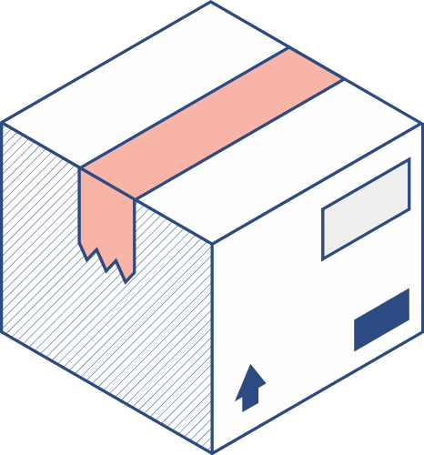


METHODOLOGY
DATA EXTRACTION FROM LAMUDI USING BS4
EXPLORATORY DATA ANALYSIS (EDA)
KMEANS CLUSTERING IN TERMS OF SIZE, LOCATION AND PRICE
PRICE PREDICTION OF PROPERTY LISTINGS IN DIFFERENT METRO MANILA CITIES USING REGRESSION
DATA VISUALIZATION USING GEOPANDAS AND CANVA CHARTS

Slide 7
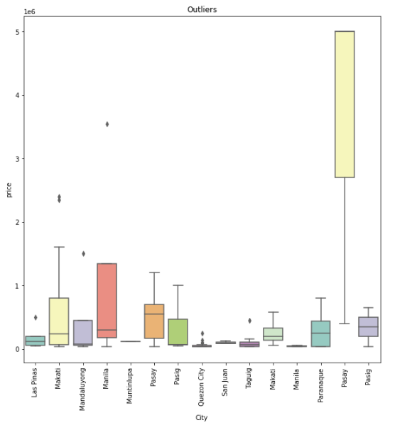

WE FOUND 137 OUTLIERS FROM A TOTAL OF 1315 PROPERTY LISTINGS IN METRO MANILA
THE AVERAGE RENT FOR THESE PROPERTIES IS
₱400,000

Slide 8



AVERAGE AMENITIES OF THE OUTLIERS
17
BED
9
BATH
338
SPACE

Slide 9
Dropped Outliers
10.4%
1178
PROPERTY LISTINGS WERE
LEFT FOR DATA ANALYSIS
Remaining Data
89.6%

Slide 10
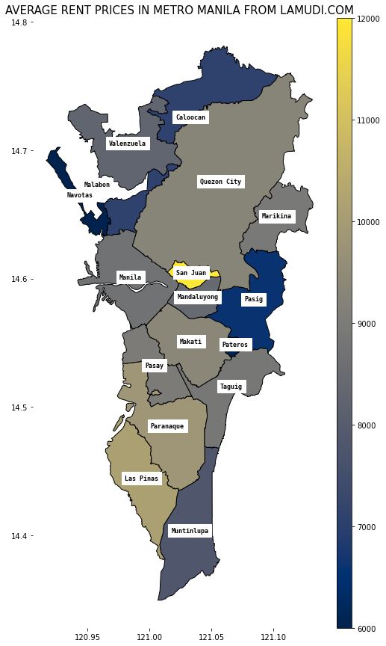
TOP 5 MOST EXPENSIVE CITIES IN NCR
12,500
10,000
7,500
RENT PRICE
5,000
2,500
0
San Juan
Las Pinas
Paranaque
Makati
Quezon City
CITY

Slide 11
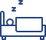


TOP 5 MOST EXPENSIVE CITIES IN NCR
SAN JUAN
LAS PINAS
PARANAQUE
MAKATI
QC
1.33
1.51
1.69
1.69
1.69
1.00
1.26
1.17
1.57
1.25
24.44
39.70
37.36
26.89
32.05

Slide 12
TOP 5 LEAST EXPENSIVE CITIES IN NCR
8,000
6,000
RENT PRICE
4,000
2,000
0
Pateros
Navotas
Pasig
Caloocan
Muntinlupa
CITY

Slide 13
TOP 5 LEAST EXPENSIVE CITIES IN NCR
NAVOTAS
Pateros
Pasig
Caloocan
Muntinlupa
2.00
1.00
1.80
1.41
2.76
1.00
1.00
2.84
1.10
1.59
40.00
12.50
33.53
57.76
63.31

Slide 14
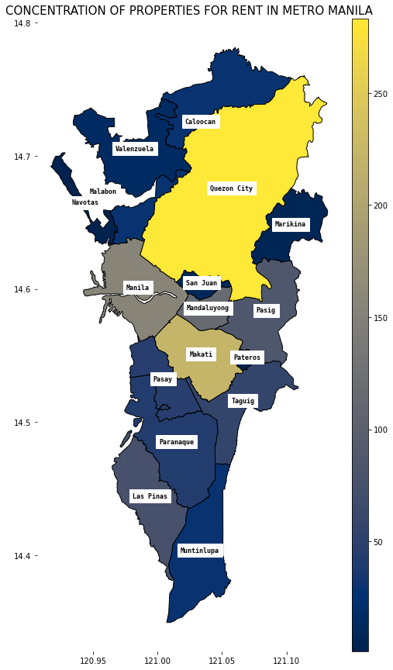
Quezon City
Makati
Manila
CITY
Mandaluyong
Pasig
0
100
200
300
NUMBER OF PROPERTY LISTINGS
THE PROPERTIES FOR RENT ARE CONCENTRATED IN THESE CITIES:
QC, MAKATI, MANILA, MANDA & PASIG

Slide 15

600
THE PROPERTY TYPES ARE MOSTLY COMPOSED OF
APARTMENT, BEDSPACE, ROOM,
AND CONDOMINIUM
400
NUMBER OF PROPERTY LISTINGS
200
0
Apartment
Bedspace
Studio Room
Condo
PROPERTY TYPE

Slide 16
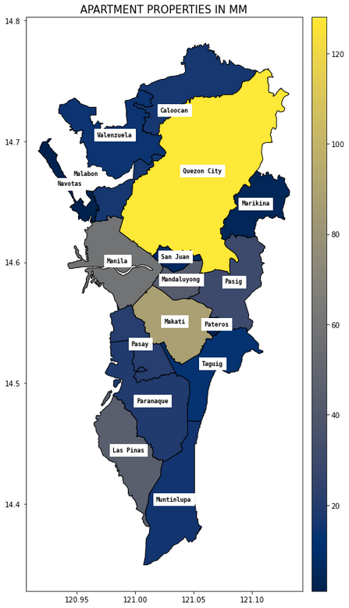
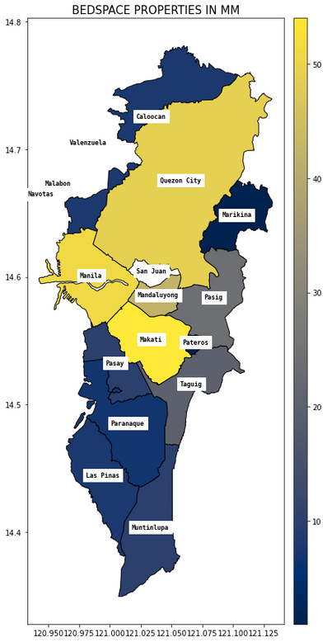
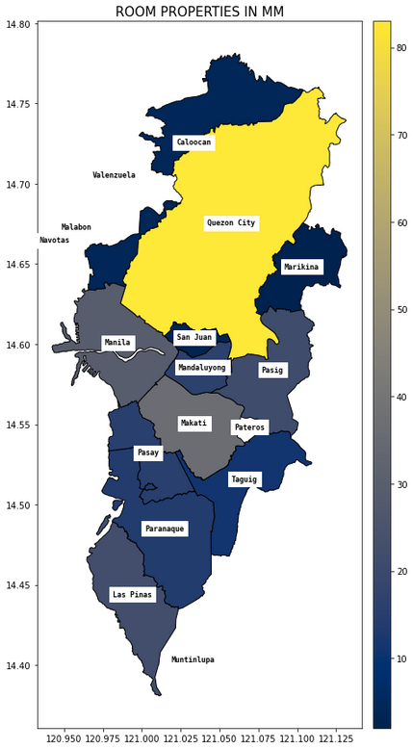
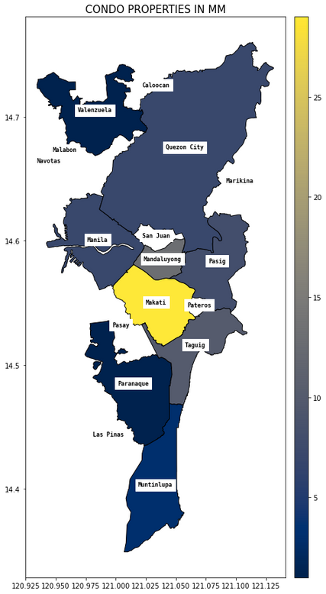
APARTMENT TYPE LISTINGS ARE PLENTY IN QUEZON CITY, MAKATI AND MANILA

Slide 17
BEDSPACE TYPE LISTINGS ARE SCATTERED IN LARGER PARTS OF THE METRO

Slide 18
STUDIO TYPE LISTINGS ARE PLENTY IN QUEZON CITY ALONE

Slide 19
LASTLY, CONDOMINIUM TYPE LISTINGS ARE PLENTY IN MAKATI CITY

Slide 20

THE PRICE
Bedspace
Condo
PROPERTY TYPES
Room
Apartment
0
2,500
5,000
7,500
10,000
12,500
RENT PRICE

Slide 21
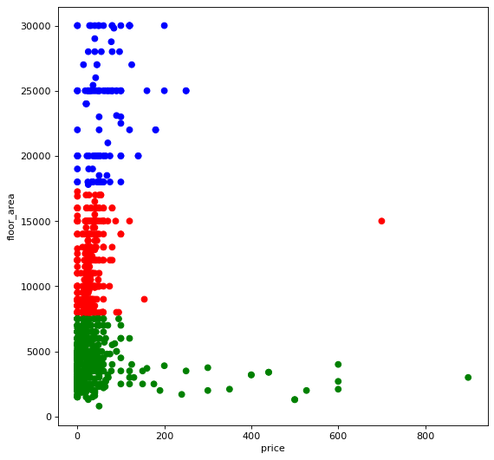
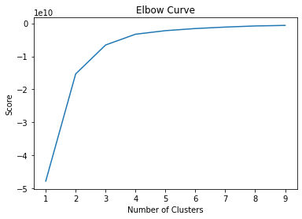
THE CLUSTERS SHOW THAT THE FLOOR AREA AND PRICE ARE NOT DIRECTLY CORRELATED.
K=3

Slide 22
₱ 4300
614 LOW RANGE PROPERTIES
AVERAGE RENT PRICE
Valenzuela
6,300
Navotas
6,000
Marikina
5,166
Las Pinas
5,108
San Juan
5,000
TOP 5 MOST EXPENSIVE CITIES IN LOW RANGES CLUSTER

Slide 23
₱ 11000
442 MID RANGE PROPERTIES
AVERAGE RENT PRICE
Pasay
12,153
San Juan
12,000
Marikina
11,750
Quezon City
11,735
Paranaque
11,590
TOP 5 MOST EXPENSIVE CITIES IN MID RANGE CLUSTER

Slide 24
₱ 24000
122 HIGH RANGE PROPERTIES
AVERAGE RENT PRICE
Paranaque
25,857
Pasig
25,500
Las Pinas
24,214
Makati
24,039
Quezon City
24,032
TOP 5 MOST EXPENSIVE CITIES IN HIGH RANGE CLUSTER

Slide 25

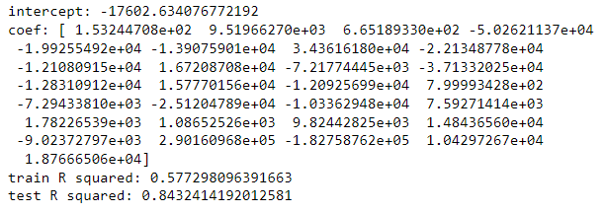
ML: REGRESSION
THE PRICE OF THE PROPERTY LISTING CAN BE PREDICTED WITH AN R2=0.84 IF THE NUMBER OF BEDROOMS, BATHROOM, AREA AND CITY LOCATION ARE GIVEN

Slide 26
TAKEAWAYS
THE MAIN CONTRIBUTOR TO A PROPERTY LISTING'S RENT PRICE ARE ITS LOCATION AND PROPERTY TYPE,
FROM THE CLUSTERS MADE; LOW, MID AND HIGH RANGE, IT CAN BE CONCLUDED THAT THE AVERAGE RENT PRICE FOR THE NCR CITIES,
THE PRICE PREDICTION MODEL CAN BE IMPROVED IF MORE ROWS AND FEATURES SUCH AS AMENITIES CAN BE PROVIDED.
RECOMMENDATION FOR RENTERS
FOR RENTERS WHO PREFER TO HAVE MORE CHOICES, THE CITY WITH MOST NUMBER OF PROPERTY TYPES CAN BE DETERMINED,
CONSIDERING BUDGET OF THE RENTERS, THE RENTERS CAN START THE HUNT OF THEIR PROPERTY CHOICE WITH THE CITIES WITH,
BEDSPACES RENT PRICE ARE SIGNIFICANTLY LOWER THAN THE OTHER TYPES. TRADEOFFS SUCH AS PRIVACY SHOULD BE MADE CLEAR BY RENTERS.

